Slide 1

Ergonomics Summer Break Week 1

Slide 2
What had been discussed last week
Think of our uniqueness of our research
Think of our research title

Slide 3
Timeline
Content | Date | Progress
Learning Basics of Deep Learning | Sep 2022 | Done
Installing VideoPose3D | Sep-Oct 2022 | Done
Learning Ergonomics Basics | Oct-Nov 2022 | Done
Forming a Framework of Time Continuous Cumulative Fatigue
Preparing for Final Exam | Nov-Dec 2022 | Done
Review the Time Continuous Cumulative Fatigue Framework | Dec 2022 | Done
Trying to Extract Coordinates Using Alphapose/Openpose | Dec 2022
Adding on a Cumulative Fatigue Assessment using VideoPose3D with Python | Jan-Mar 2023 | Done
Writing a Technical Report for our Research | Mar 2023

Slide 4
Challenges of Applying OpenSim
IKresults.mot
Inverse Dynamics
.trc
External forces
(Our Goal)
.c3d file
grd.mot
Vicon’s output
Video
Our algorithm

Slide 5




















Revision of Our Framework
Linear Kinematics Quantities
Upper Torso
2
y’’
0
1
2
3
x’’
y’’’
B
dt =
1
y’’’’
3
Angular Kinematics Quantities
fps
y’
4
x’’’
C
D
x’’’’
(Magnitude)
x’
A
(Direction)
y
1
x
O

Slide 6






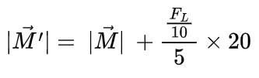



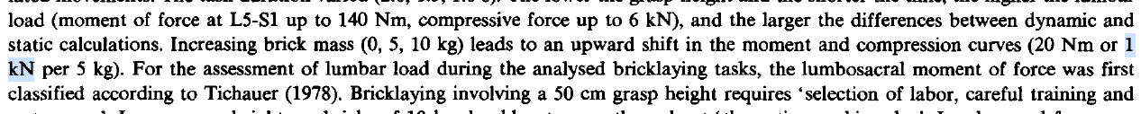
Revision of Our Framework
Axial Force (assume load = 5kg)
Bending Moment (assume load = 5kg)

Slide 7







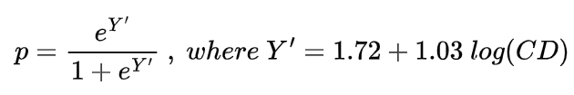
Revision of Our Framework
Total Lumbar Compressive Force (assume a = 5)
Probability of Injury Risk

Slide 8
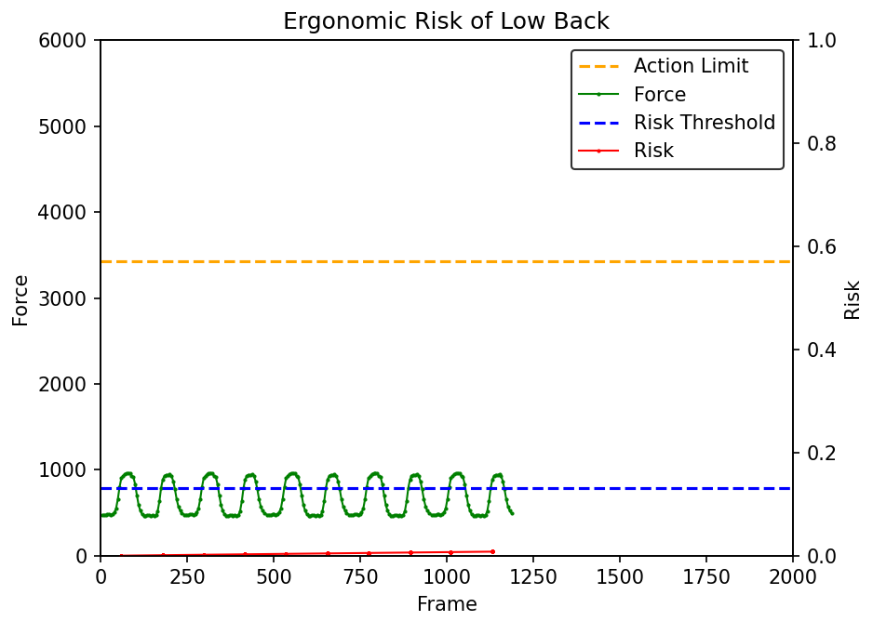
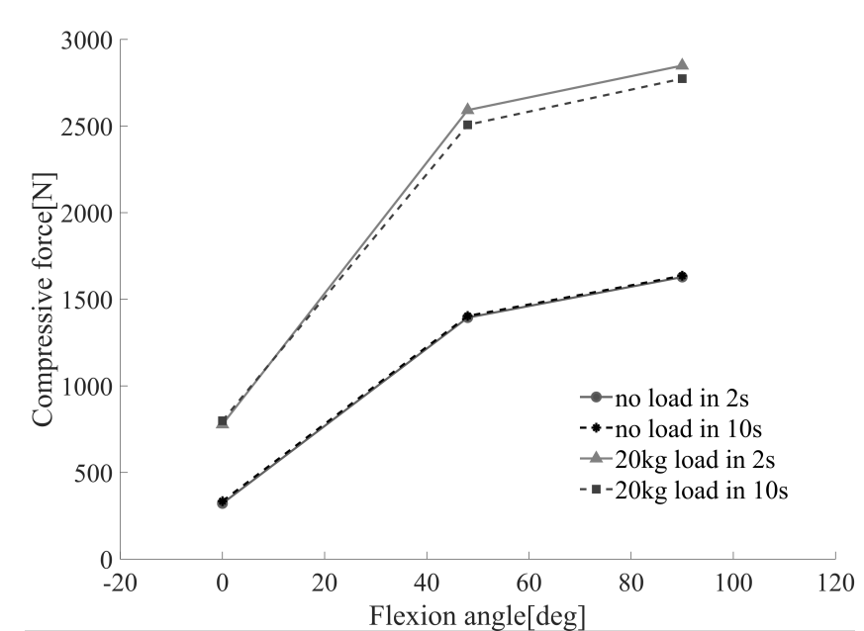
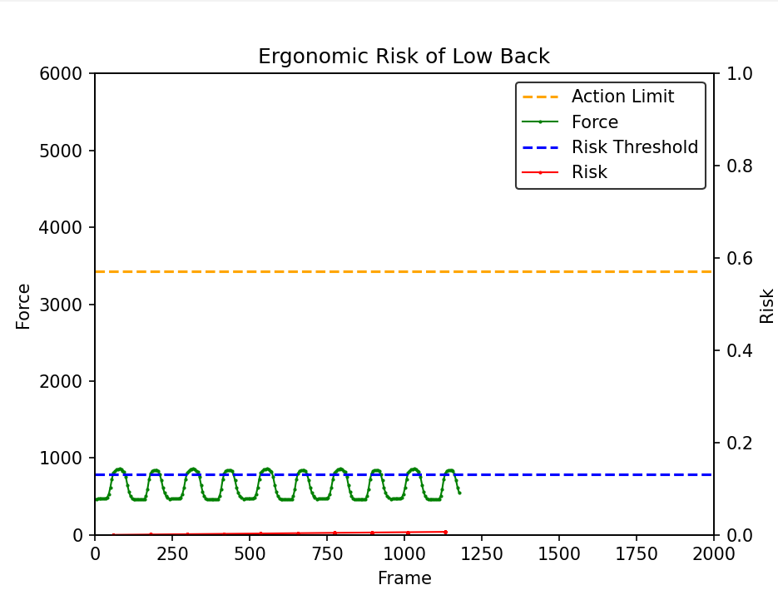
Body Weight: 600 N
Load: 0 N
a: 5
Validation of Lumbar Compressive Force Simulation in Forward Flexion Condition
a: 4

Slide 9
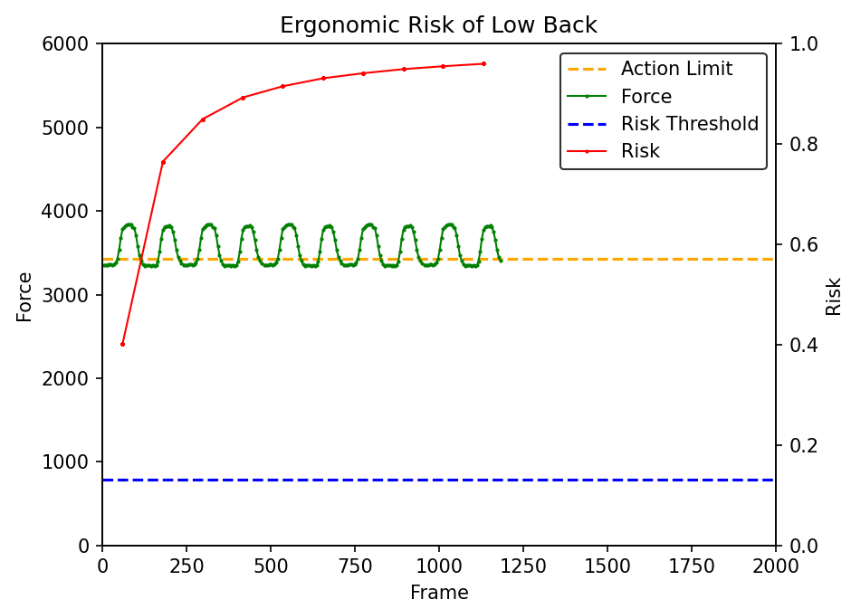
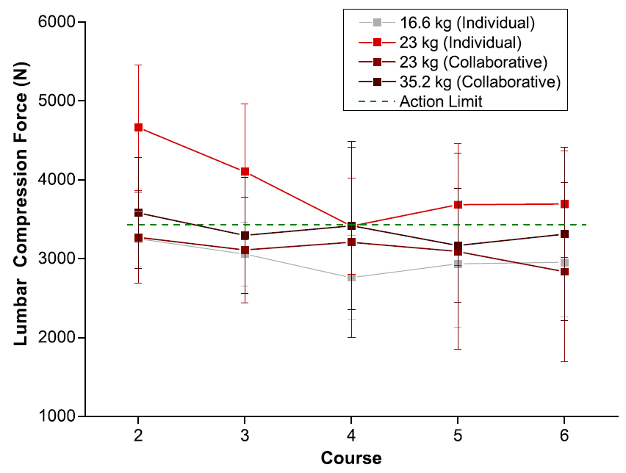
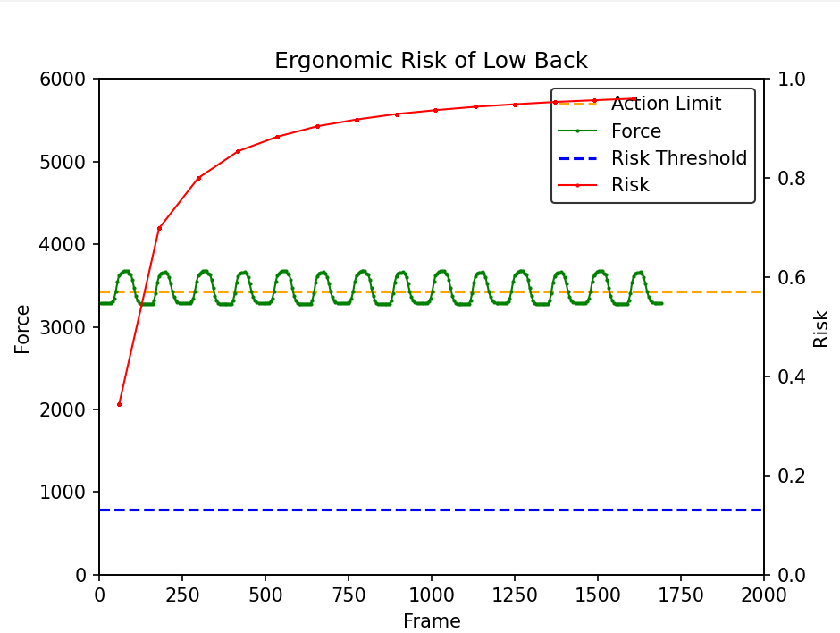
Body Weight: 600 N
Load: 160 N
a: 5
(Ryu et al. 2023) Ergonomic characteristics of expert masons
a: 4

Slide 10
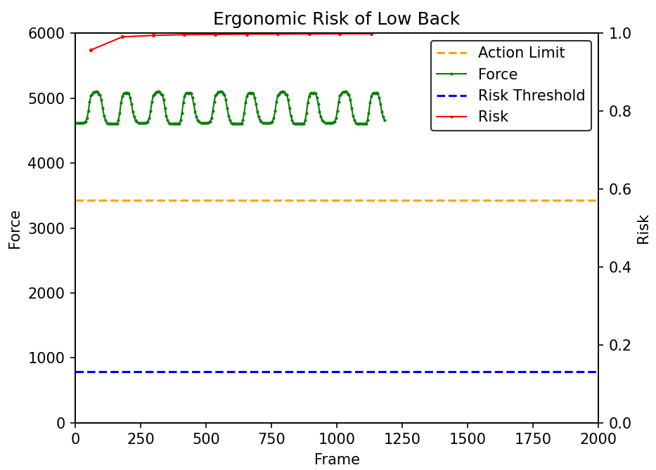
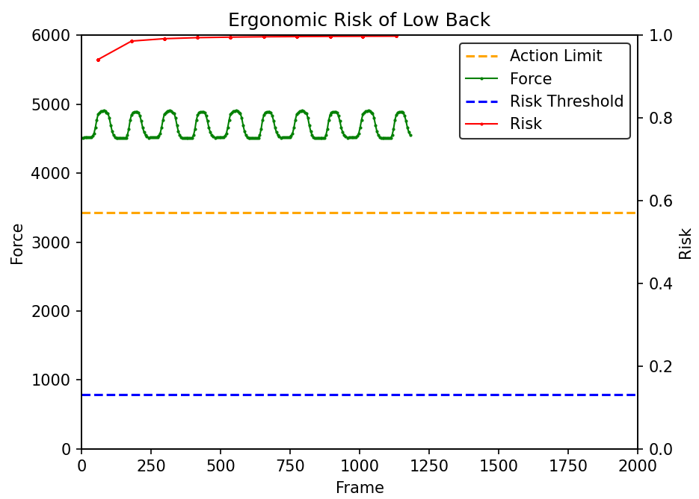
Body Weight: 600 N
Load: 230 N
a: 5
a: 4

Slide 11
Conclusion
Video input
Camera’s Frame Rate
More convenient (Simplification of the process)
3D coordinates
Vector Algebra
Accelerations at 1 frame before
Parameter a-Method
More flexible to fine tune (Customization for different groups)
Forces at Joints

Slide 12
Research Uniqueness
We use our own algorithm to estimate accelerations and forces and validate our result by comparing it to a different method.
We combine monocular vision-based pose estimation (Videopose3D) and ergonomic cumulative damage model to assess the injury risk.

Slide 13
Next Meeting
Drafting abstract
For URECA and conference, this is enough, but for journal paper, need to wait for Prof to contact with Dr Ryu to ask for his dataset.

